Slide 1
The Adventures of Malice in Py-Land
CST205 – Final Project

Slide 2
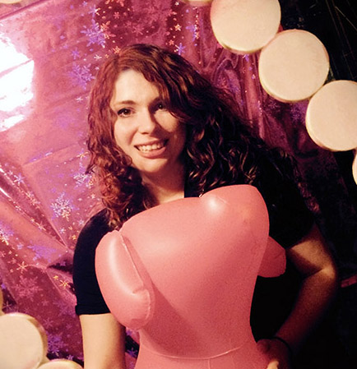

Team Members
Caitlin Kuleck
Luciano Avendano

Slide 3
Objective
Objective - what are you planning to accomplish for the final project?
With this project, the intent is to create a text-based game in which Malice is dropped into Py-Land.
In each area of the map, she must make a choice, and that choice determines what happens to the map.
This will be put into effect by use of picture functions, distorting what the area would have been.
An image will be attached to each ‘room’, and it will display to the screen what her choice has done.

Slide 4
Approach
We started our project by drawing a map.
The map was then color-coded and it was decided what would happen in each area.
Luciano drew up the map, while Caitlin added in the additional information.
Coding was done both individually and together, with image effect functions being put together mostly by one person and text game statements put together by the other.
https://github.com/ktkitkat/CST205-Final-Project

Slide 5
Responsibilities
Luciano Avendano
Caitlin Kuleck
Initial Mapping
Picture Coding
Text Coding
Video Presentation
Final Mapping
Game Planning
Text Coding
Video Script

Slide 6
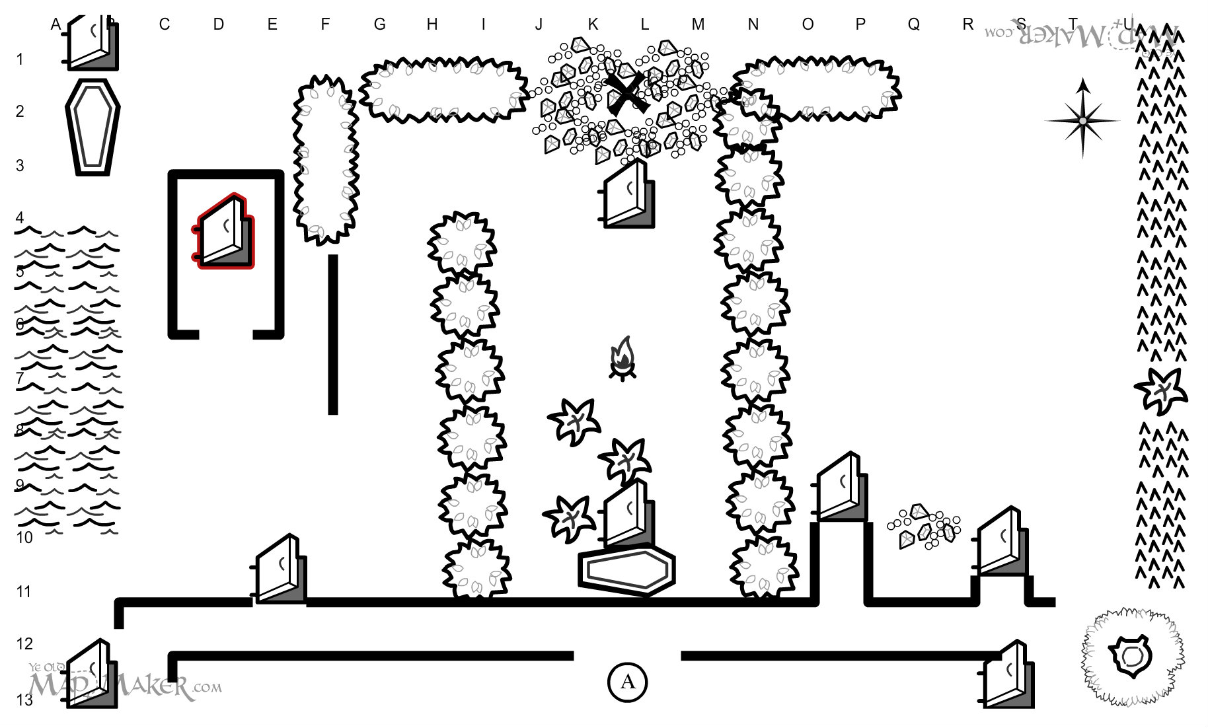
Initial MapPing

Slide 7
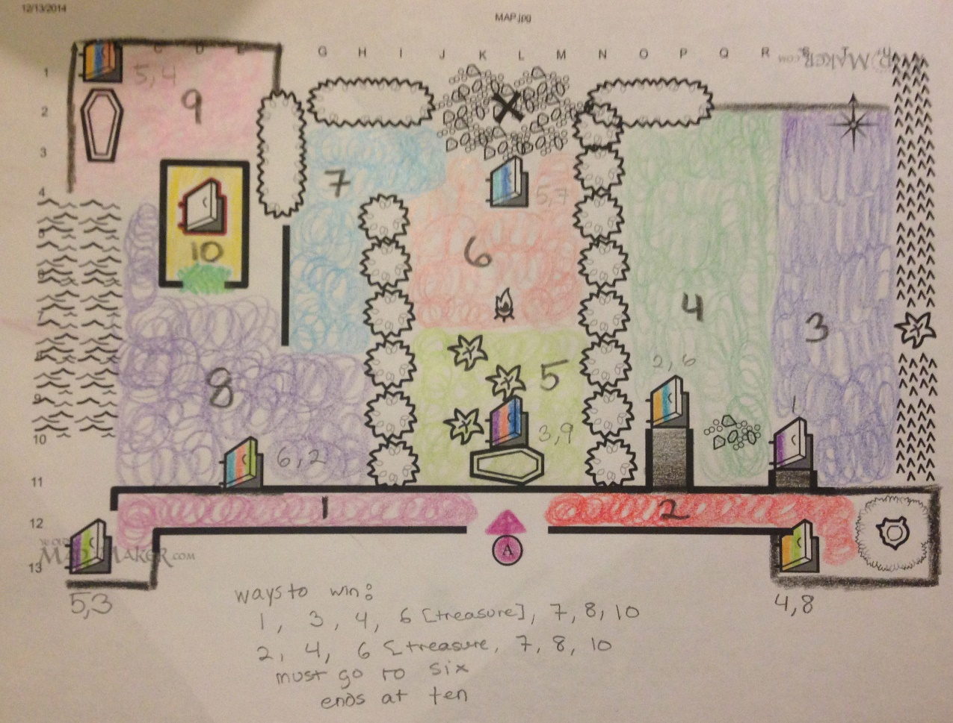
In Progress Mapping

Slide 8
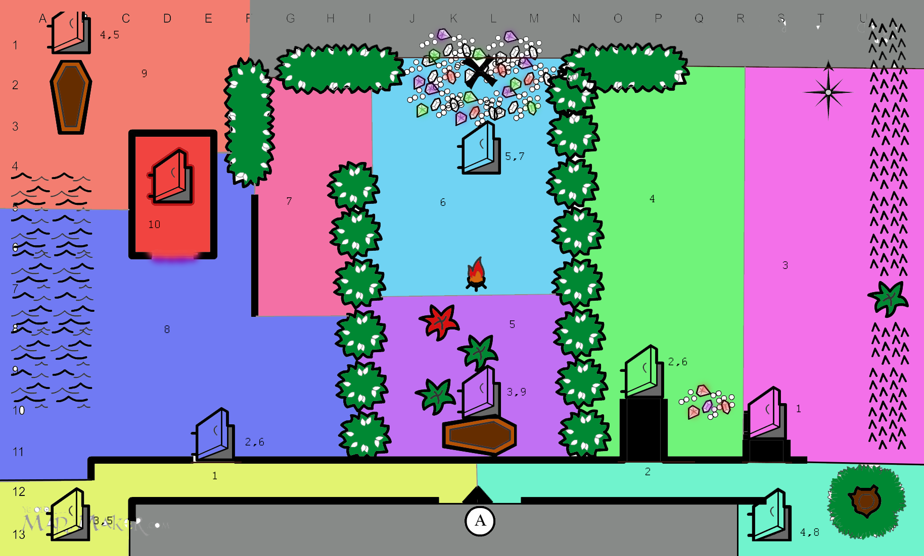
Final Mapping

Slide 9
Results
Text game and photo manipulation goals were achieved.
We were able to represent the skills we learned in class.
We were able to incorporate string processing, image manipulation, and list building.
All aspects of the game work very well and we are proud of our accomplishments.

Slide 10
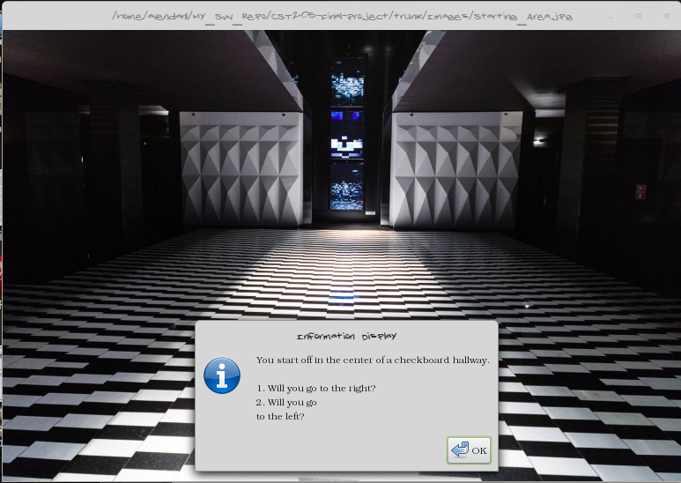
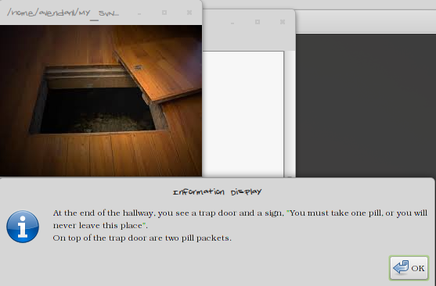
Demonstration
This displays the opening of our game: Which path do you choose?
In many of the areas are trap doors. It’s hard to know where they will lead you next.

Slide 11
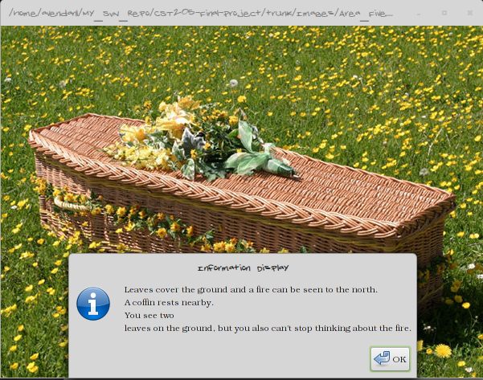
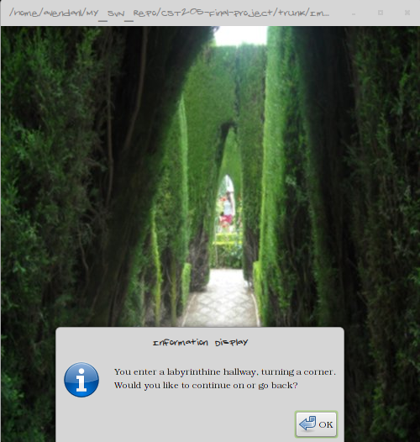
Demonstration Cont.
It’s such a pretty area. Do you really want to leave?
Some areas are more confusing than others, while others are less confusing than you think.

Slide 12
Top Three
I was extremely excited to learn how to use Git. It’s change how I do things.
Pair programming has been a great experience, although I actually thought it was going to be terrible.
Being able to manipulate pictures or sound without the use of Photoshop is an interesting skill I never thought I would have.
- Caitlin Kuleck
I enjoyed learning python from a completely different perspective. I listened to all my classmates input and ideas and it made the course worthwhile.
Pair programming was a must for some projects as difference in schedules was a challenge at times. This was tailored to real world scenarios and many lessons learned from keeping to a schedule in software delivery.
Learning GitHub was interesting and fun, I will definitely be using more of it to host future projects.
- Luciano Avendano

Slide 13
Links
Group Project Status Document
GitHub Repository
Project Video

